Slide 1
Python Basics
Last Updated: 5/24/2018

Slide 2
References
https://www.tutorialspoint.com/python/index.htm

Slide 3
Introduction
This tutorial is for absolute beginners who have little experience with programming languages

Slide 4
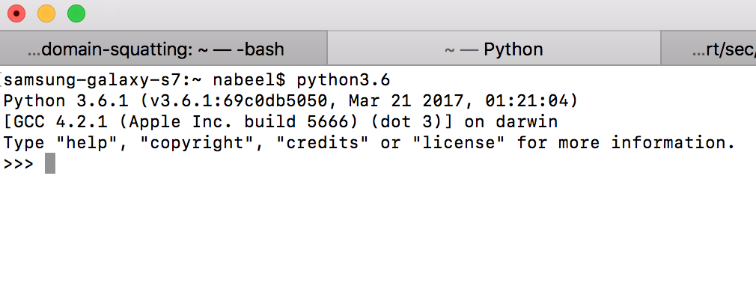
Different modes
Interactive mode
In the command line, type “python” (Since I have Python 2.7 and 3.6, I need to type python3.6 to access 3.6 version)
It will take you the interactive mode

Slide 5
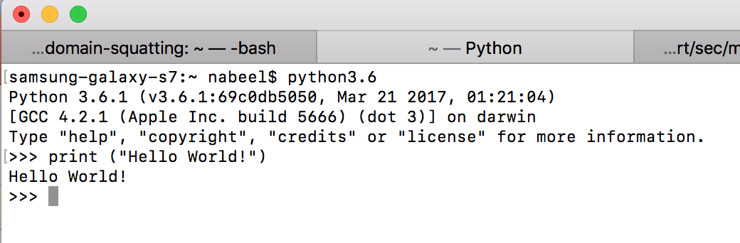
Interactive Mode
This is a great way to test simple code snippets, but not good for writing full fledge codes.
Printing Hello World!

Slide 6
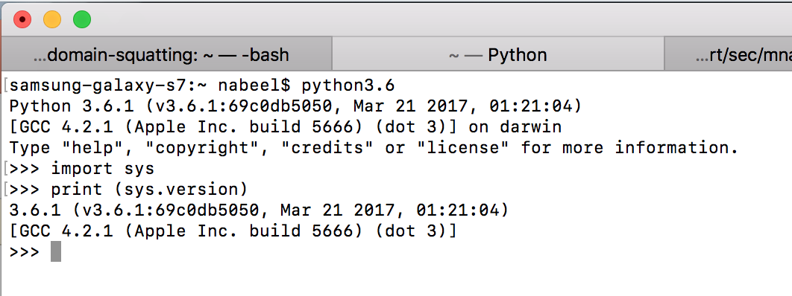
Interactive Mode
Another Example – Importing sys package and printing the Python version by calling the function sys.version
Type quit() or exit() to exit the interactive mode

Slide 7
Non-Interactive Mode
You write the code and save in a .py file (say example.py)
You can either run it from the python shell or from command line
Syntax to run from command line:
python <filename>
E.g.: python example.py

Slide 8
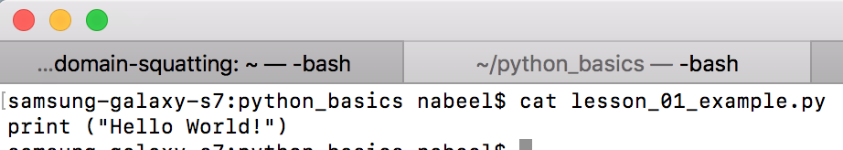
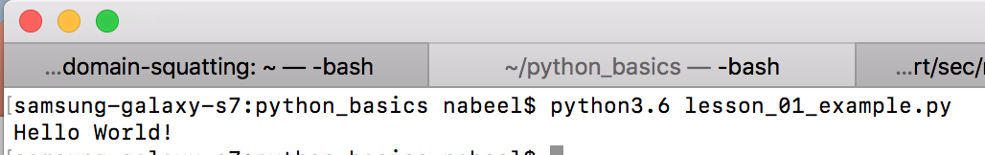
Windows Command Line
lesson01_example.py file
It has one line of code
Running the code in the command line

Slide 9
Three Ways of Writing Python Programs
Unstructured
Procedural
Object Oriented

Slide 10
Unstructured Program
The code is executed from top to bottom
There are no functions or classes defined in the program
Usually this way of coding is not encouraged unless it is a small program
All the variables in the program are global variables

Slide 11
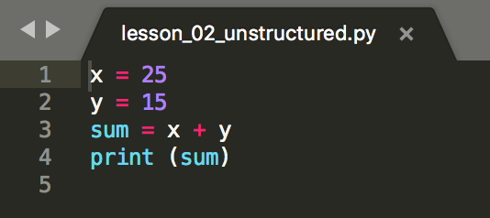
Unstructured Programs
The following program defines two global variables x and y and assign integers 25 and 15 respectively.
Defines another variable called sum and assign the summation of x and y to it
Finally it prints the value in sum which is 50

Slide 12
Procedural Programs
You define functions to group code into functional units
Call the functions to get the job done
This is a preferred way of writing codes

Slide 13
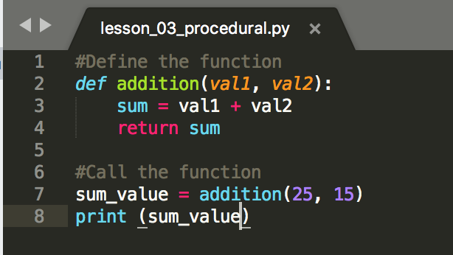
Procedural Program
Define a function named “addition” with two input parameters “val1” and ”val2”. These input parameters are expected to be integers.
Create a local variable called “sum” and assign the sum of val1 and val2 to sum variable
Return the value of sum variable
Call the function addition with two input values 25 and 15 and assign the return value to the variable called sum_value
Print the value in sum_value variable

Slide 14
Object Oriented Programs
You define class level attributes and methods
There is a constructor to initialize default values
Always pass the keyword “self” to identify the class itself (it is Python specific)
self.<attribute-name> to refer to a attribute defined inside the class
self.<method-name> to refer to a method defined inside the class

Slide 15
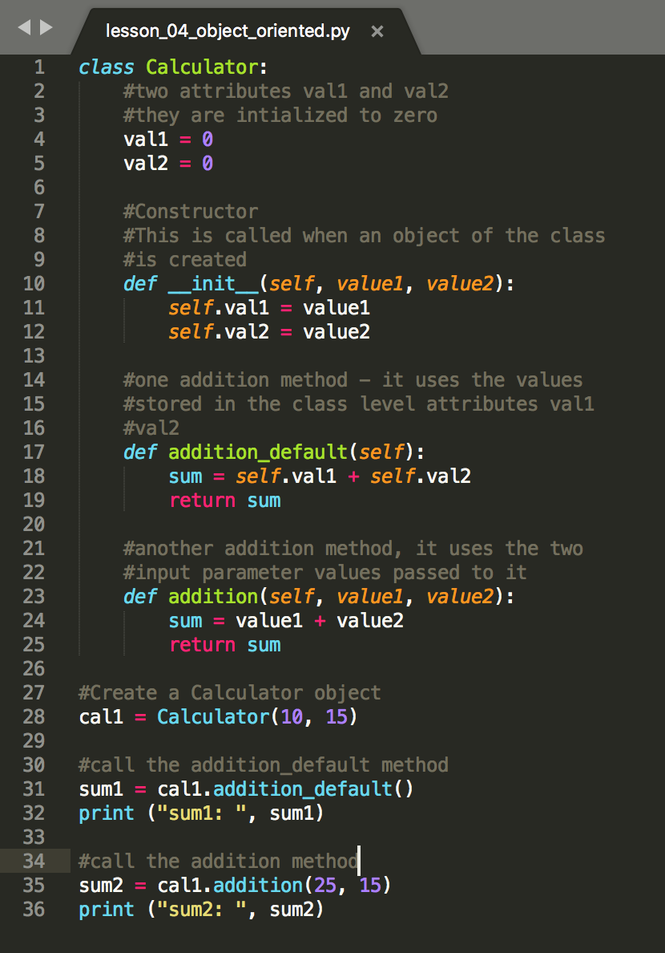
Object Oriented Programs

Slide 16
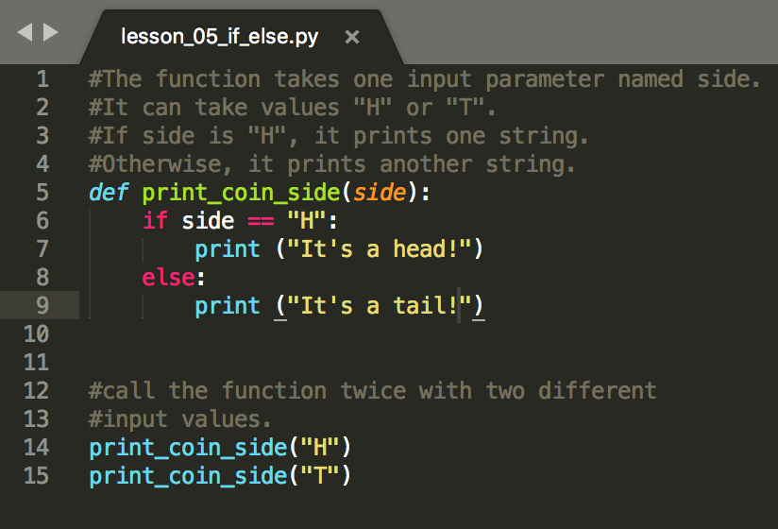
If-else Control Block

Slide 17
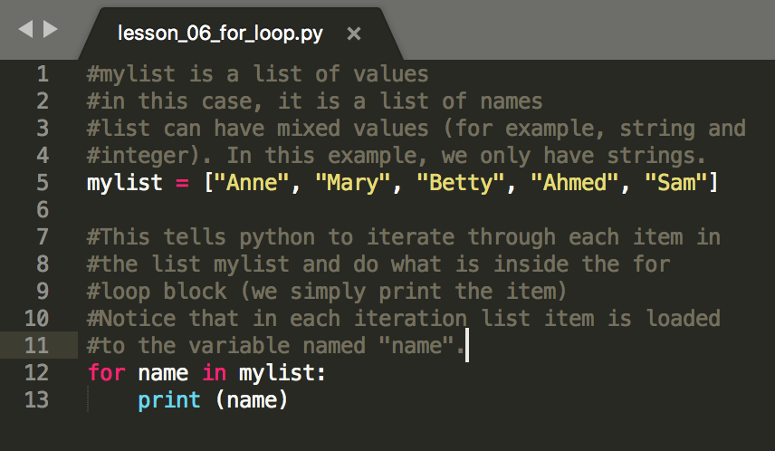
For-loop control block

Slide 18
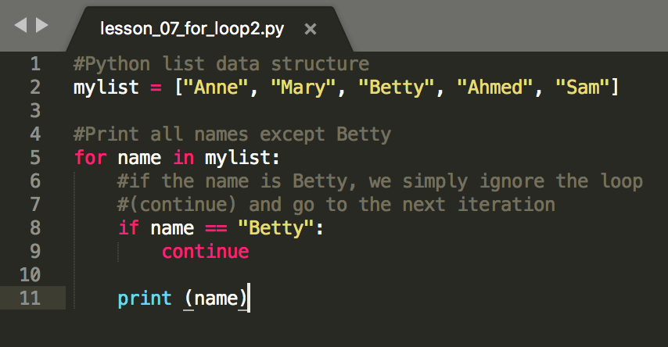
For loop with continue

Slide 19
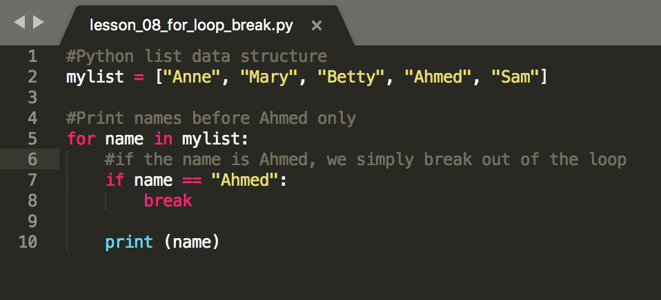
For loop with break

Slide 20
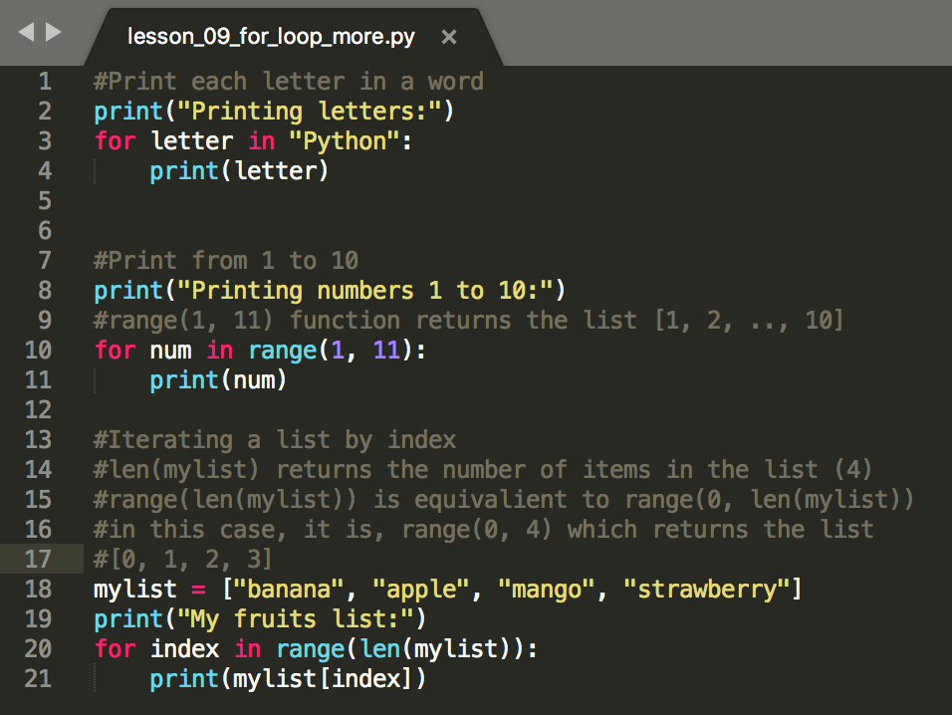
For loop – More examples

